Slide 1

LLM Reinforcement Learning
Xia Ziye
2025/01/01

Slide 2

01
Classical Search to RL
02
Tabular Q-Learning
03
Deep Q-Networks
CONTENTS
04
Policy Gradient Methods
05
Conclusion

Slide 3

01
Classical Search to RL

Slide 4



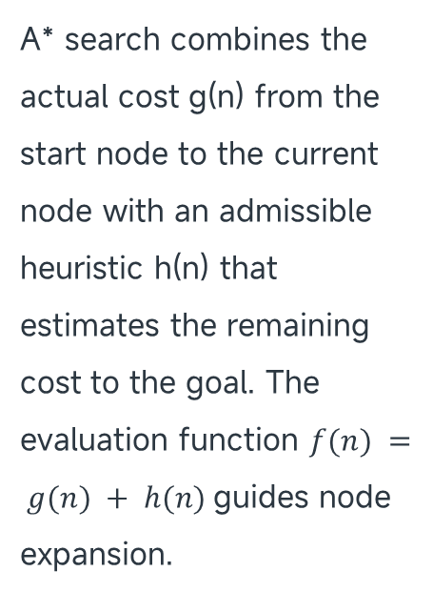
A* Search Guarantees Optimality
Optimality Guarantee
If the heuristic h(n) is admissible, meaning it never overestimates the true cost, A* guarantees finding the optimal solution. This makes it highly effective for deterministic pathfinding problems.
A* Core Components
A* search combines the actual cost g(n) from the start node to the current node with an admissible heuristic h(n) that estimates the remaining cost to the goal. The evaluation function $f(n) = g(n) + h(n)$guides node expansion.
Limitations of A*
However, A* requires a complete environmental model and cannot handle randomness, partial observability, or high-dimensional state spaces, which limits its applicability in more complex scenarios.

Slide 5
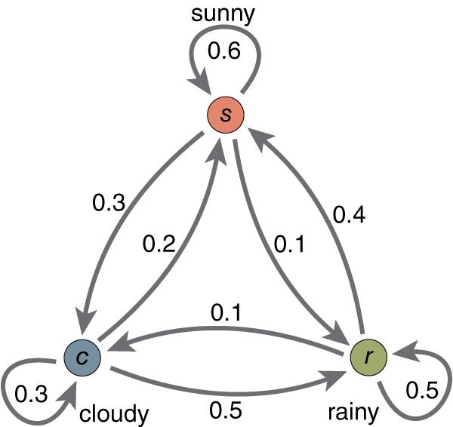

Markov Decision Processes Formalize RL
MDP Definition
Objective in MDPs
$$(ℳ=\left\langle S,A,P,R,γ\right\rangle )$$
Reinforcement learning is formalized through Markov Decision Processes (MDPs), defined by the five-tuple ⟨S, A, P, R, γ⟩. States (S) represent situations, actions (A) change states through stochastic transitions P, and rewards (R) quantify immediate desirability.
The objective in an MDP is to maximize the expected cumulative reward, expressed as the sum of discounted rewards over time. This framework allows agents to learn optimal policies through interaction.

Slide 6
02
Tabular Q-Learning

Slide 7
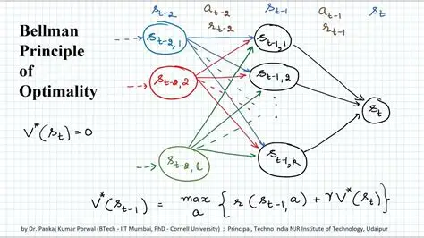

Bellman Optimality Equation
Bellman Optimality
$Q^{∗}\left(s,a\right)=E_{s^{′}∼P\left(⋅ | s,a\right)}\left[R\left(s,a,s^{′}\right)+γ\max_{a^{′}}{Q^{∗}}\left(s^{′},a^{′}\right)\right]$
The Bellman optimality equation states that the optimal action-value Q*(s, a) equals the immediate reward plus the maximum value of the next state, discounted by γ. This recursive relationship underpins value-based reinforcement learning.

Slide 8

Q-Learning Update Rule
$$Q\left(s_{t},a_{t}\right)←Q\left(s_{t},a_{t}\right)+α\left[r_{t+1}+γ\max_{a}{Q}\left(s_{t+1},a\right)−Q\left(s_{t},a_{t}\right)\right]$$
01
02
03
Update Mechanism
Off-policy Learning
Convergence Conditions
Q-learning updates its action-value estimates using the temporal-difference error between the current estimate and the newly observed reward plus the best next-state value. The learning rate α controls the update step size.
A key feature of Q-learning is its off-policy nature, allowing it to learn the optimal policy even if the agent follows a different exploration policy. This flexibility enhances its applicability.
Under the Robbins-Monro conditions on the learning rate α and infinite visitation of every state-action pair, Q-learning converges to the optimal Q-function with probability one for finite MDPs.
Result: xiaziye/RL_for_Agent

Slide 9
03
Deep Q-Networks

Slide 10

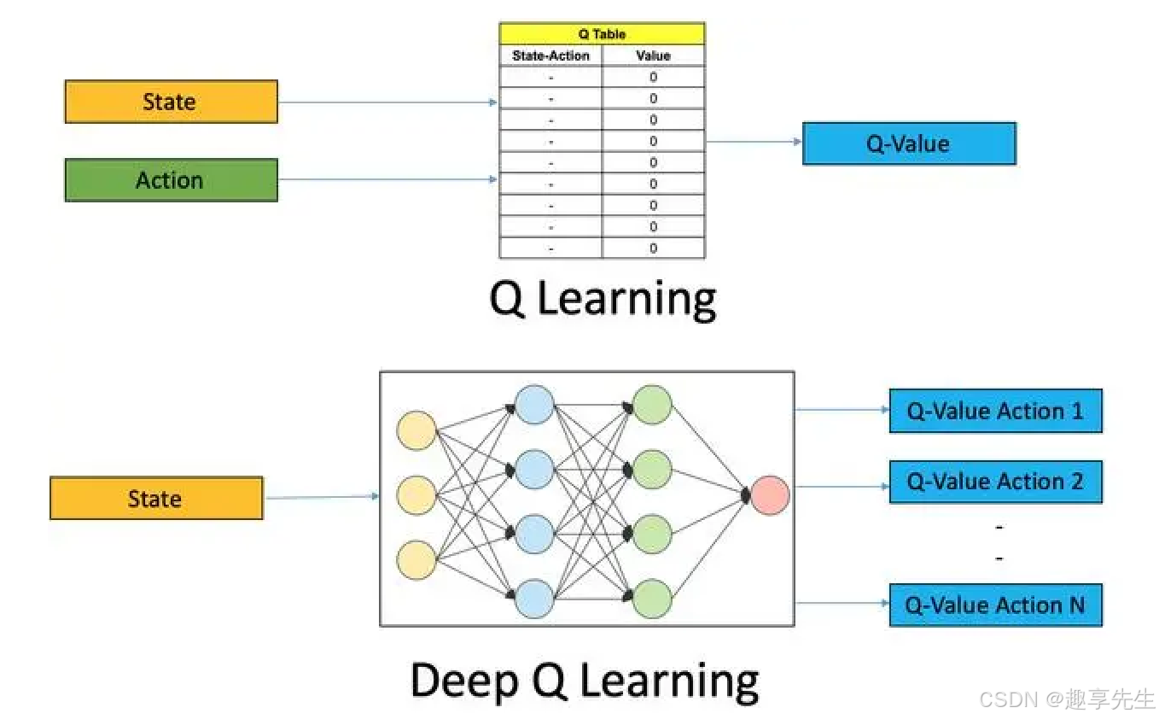
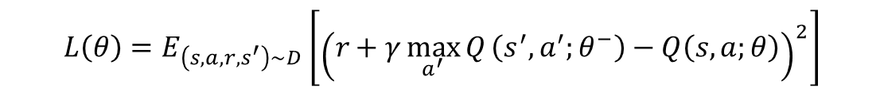
Curse of Dimensionality
$$L\left(θ\right)=E_{\left(s,a,r,s^{′}\right)∼D}\left[{\left(r+γ\max_{a^{′}}{Q}\left(s^{′},a^{′};θ^{−}\right)−Q\left(s,a;θ\right)\right)}^{2}\right]$$
Dimensionality Challenge
DQN's Solution
High-dimensional or continuous state spaces make tabular methods infeasible due to the curse of dimensionality. Function approximation, particularly using neural networks, addresses this by generalizing across similar states.
Deep Q-Networks (DQN) employ neural networks to approximate the action-value function, enabling agents to handle complex, high-dimensional inputs like raw pixel arrays in Atari games.

Slide 11
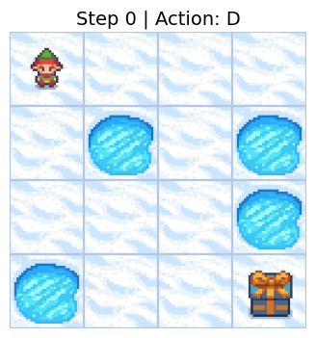
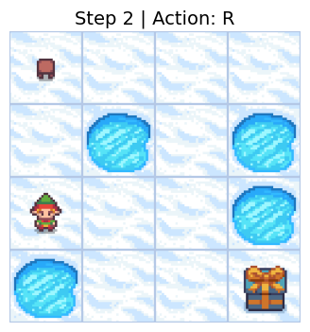
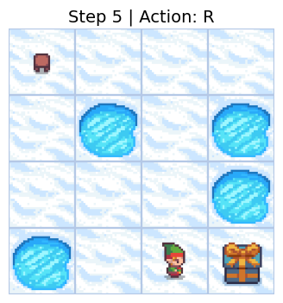
FrozenLake Case Study
Case Study Overview
01
The FrozenLake task demonstrates challenges in applying reinforcement learning to large language models, including representation mismatch and inefficient exploration.
Lessons Learned
02
The case study highlights the need for task-specific state representations, shaped rewards, and data-efficient algorithms when combining LLMs with classic RL benchmarks.

Slide 12
04
Policy Gradient Methods

Slide 13
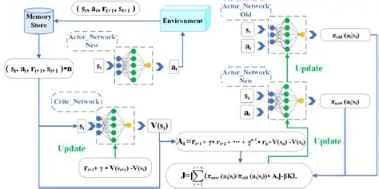
Proximal Policy Optimization
PPO Core Idea
PPO limits the magnitude of policy updates using a clipped surrogate objective, ensuring stable and monotonic improvement in policy performance.
Clip Objective Function
Practical Advantages
The clip objective function prevents large policy updates by clipping the probability ratio, balancing exploration and exploitation effectively.
PPO is simple to implement, robust to hyperparameter choices, and widely used for fine-tuning large language models and other complex reinforcement learning tasks.
$$L^{CLIP}\left(θ\right)=E_{t}\left[\min\left(r_{t}\left(θ\right)\hat{A_{t}},\text{clip}\left(r_{t}\left(θ\right),1−ε,1+ε\right)\hat{A_{t}}\right)\right]$$

Slide 14


Sparse Reward Challenge
Reward Sparsity
Reward Shaping
Importance of Shaping
Language generation tasks often provide reward only at sequence completion, making it difficult to assign credit to individual actions.
Reward shaping techniques, such as adding heuristic potentials based on language model likelihood, help guide exploration and reduce variance in gradient estimates.
Without proper reward shaping, learning in sparse reward environments can be inefficient and lead to poor performance.

Slide 15


Direct Preference Optimization
DPO Overview
Bradley-Terry Model
Direct Preference Optimization (DPO) transforms reinforcement learning from human feedback into a supervised learning problem, eliminating the need for reward modeling.
DPO uses the Bradley-Terry model to express preferences as probabilities, allowing efficient optimization through a differentiable loss function that aligns with human judgments.

Slide 16
05
Conclusion

Slide 17


Open Challenges Ahead
Despite empirical successes, theoretical guarantees for deep RL in large language models remain fragile, with convergence proofs relying on unrealistic assumptions.
Improving sample efficiency is crucial for making reinforcement learning practical in large-scale language settings, where each interaction is computationally expensive.
Future research will likely focus on integrating world models, hierarchical planning, and continual learning to create more robust and efficient agents.
Theoretical Guarantees
Sample Efficiency
Future Directions

Slide 18
THANK
YOU
Xia Ziye
2025/12/15

